Slide 1


SNJB’S Late Sau. Kantabai Bhavarlalji Jain,
College of Engineering, Chandwad, District: Nashik
Accredited with ‘A’ Grade by NAAC
‹#›
Department of Computer Engineering
Object detection using Tensor flow
Project Guide: Prof. D. S. Rajnor
Presented by 1.Rutuja Sonawane
2.Jidnyasa Girase
3.Madhura Boralkar
4.Sakshi Dawange
Project Work Stage-II 2021-2022

Slide 2
Content
Introduction
Motivation
Problem Statement
Literature Survey(Tabular Format)
Working Dig/Architectural Dig
Software Requirement Specification
Functional Requirements
Non-Functional Requirements
System Requirements
UML Diagrams
Merits
Conclusion
References

Slide 3
Introduction
Object detection are mainly use to identify the real object from image or video for blind person and nursery children using android application through voice regonization.
Object detection deals with identifying the presence of various individual objects through camera and recognized the object.
In reading article reads the content from camera and also from image .

Slide 4
Motivation
The main purpose of this android application is to provide communication system for the Impaired Peoples and nursery children in an effective way by exploring the powers of the platform to the maximum.
This document describes this application’s capability to convert from speech to text and vice versa, a trendy feature of the Android platform for many years which can be effectively used by the Visually Impaired Peoples to communication.

Slide 5
Problem Statement
Object detection using tensor flow for blind person and nursery Children's.

Slide 6
Literature Survey
Sr. No | Year of Publication | Title | Authors | Feature
1. | 2019 | Android application development and evalution of security system | Anirban Sarkar,Ayush Goyal | Android application development: a brief overview of android platform and evalution of security system
2. | 2018 | Real time text reader | Jayshre Punsare,Adit Gaikwad | Reading the text from image and detect the letters
3. | 2016 | A Wearable Portable Electronic Travel Aid for Blind | M. T. B. R. A. A. K. Y. Kevin Labuan | The obstacle detection, where combination of visual sensors, sonar and inertial measurement unit are used to detect the presence of an obstacle and give audio as well as tactile feedback.
Object detection using Tensor flow algorithm

Slide 7
4. | 2015 | Android Phone Controlled Voice Gesture and Touch Screen Operated Smart Wheel Chair | Sharaddha Uddhav Khadilkar, Narendra Waghdarikar | In authors provided a new system prototype name as Sharojan Bridge to make more effective communication between blind people, which is a wearable device build with Iot devices
5. | 2015 | Communication among Blind, Deaf and Dumb People | Rohit Rastogi, Shashank Mittal, Sajan Agarwal | In authors provided a new system prototype name as Sharojan Bridge to make more effective communication between blind people, which is a wearable device build with Iot devices
6. | 2012 | Audio-Supported Reading for Students who are Blind or Visually Impaired, Wakefield | Jackson, Richard M. Jackson and Presley | This tool for integrating multiple pedagogies and teaching the skill sets which are need to gain literacy of blind people.
Object detection using Tensor flow algorithm

Slide 8
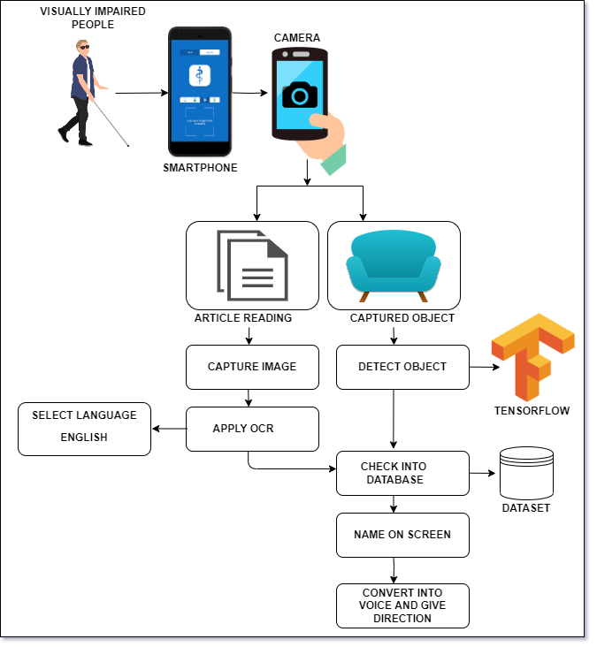
Working Diagram

Slide 9
Software Requirement Specification
Project Scope
User Classes & Characteristics
Assumptions & Dependencies & Exception

Slide 10
Project Scope
The Object Detection system in image is android based application which mainly aims to detect the multiple objects from various types of images and recognized it.
This Application is very helpful towards the visually impaired people and makes very easy for them to use electronic gadgets with (text to speech) TTS technology, they will be able to interact more efficiently to the electronic system i.e Mobile Phone.

Slide 11
User Classes and Characteristics
A. Object Detection:
I. Camera On
II. Detect object
III. Tensor Flow
IV. Name on Screen+TTS
V. Show Result.
B. Article Reading:
I. Camera/Gallery
II. Capture Image
III. Apply OCR
IV. TTS (text to speech)
V. Show Result
Object detection using Tensor flow algorithm

Slide 12
Assumptions, Dependencies & Exceptions
Assumptions:
Camera Should be intact
Training of dataset to algorithm
Ample amount of data with the name of Object an voice
Dependencies:
Accuracy Of algorithm depends on Camera as well as training of dataset
Efficiency of output is depended on Efficiency of algorithm
Exceptions:
Objects which are transparent

Slide 13
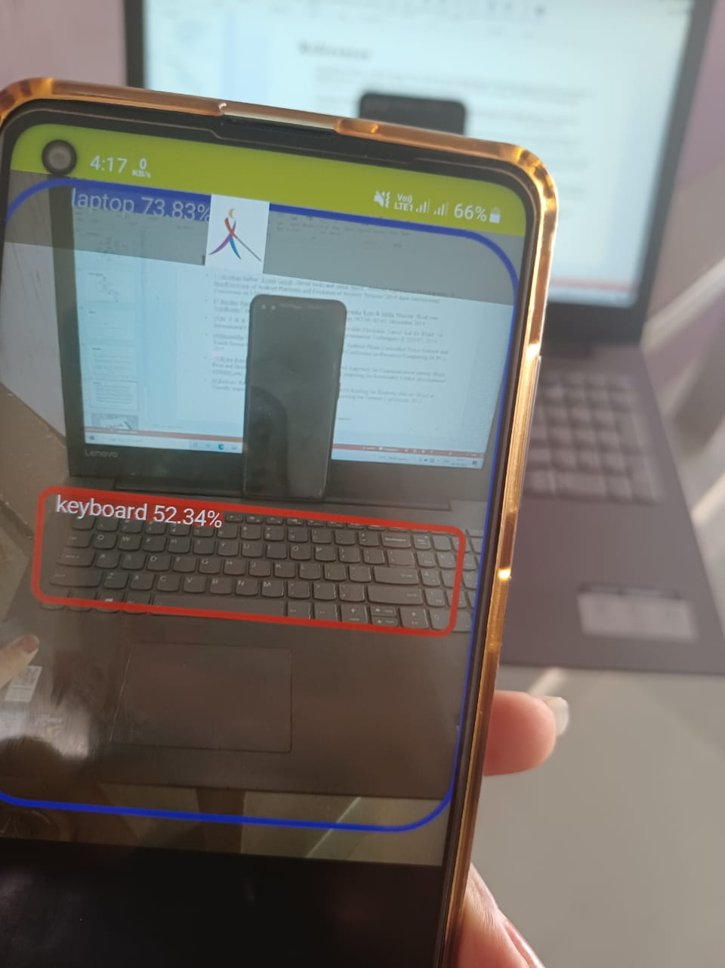
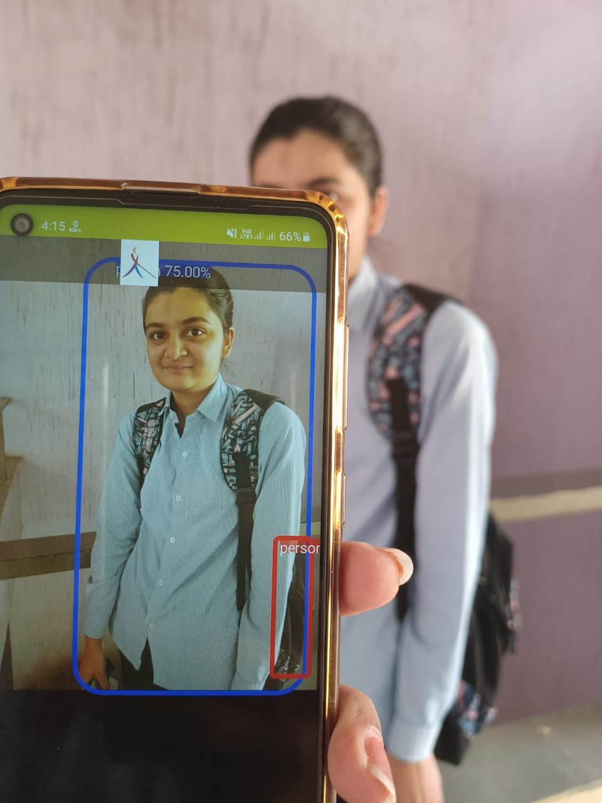
Module 1-Object Detection
Laptop
Person
Object detection using Tensor flow algorithm

Slide 14
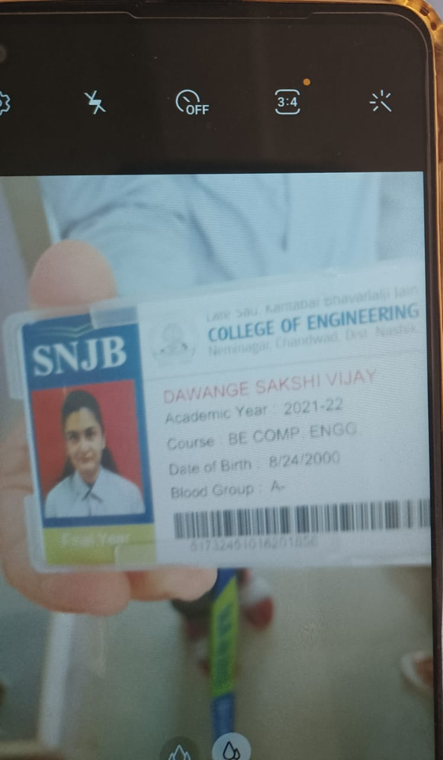
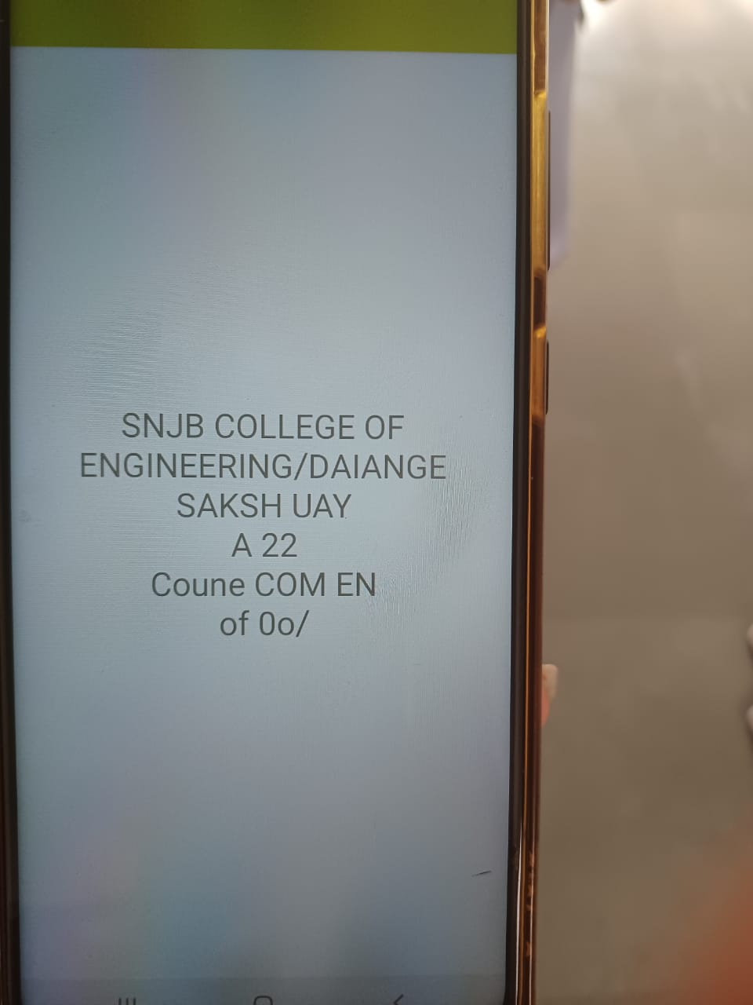
Module 2- Artical Reading
Link : https://drive.google.com/file/d/1r9ke9SRYdPgEPySgDdiX9x7aeyFgA6kR/view?usp=drivesdk
Object detection using Tensor flow algorithm

Slide 15
Functional Requirements
1. REQ-1: Capture object from the camera
2. REQ-2: With help of TTS engine the text will be read for the user
3. REQ-3:It normally converts a normal text into speech
4. REQ-4: Detection done accurately
5. REQ-5:Object Detection in real time
6. REQ-6: Capture image from the camera
7. REQ-7: With help of TTS engine the text will be read for the user

Slide 16
Non – Functional Requirements
Performance Requirements
Security Requirements

Slide 17
Performance Requirements
The system gives advice or alerts user immediately
The System gives accurate results.
Interactive, minimal delays, safe info transmission

Slide 18
Security Requirements
Nobody will be harm while developing the system
Easy to use
System embedded with management procedures and validation procedures

Slide 19
System Requirements
Database Requirements
Software Requirements
Hardware Requirements

Slide 20
Software Requirements
1.Operating System: Windows XP and later versions
2.Front End: XML
3.Programming Language: Java
4.Dataset:PPMI(Parkinson’s Progression markers Initiative)
5.Domain:Android
6.Libraries: Google Object Detection Libraries,OCR Vision API(Google),Google Talk to Speech Libraries
7.Library: TensorFlow

Slide 21
Hardware Requirements
1.Processor – i3
2.Hard Disk – 5 GB
3.Memory – 1GB RAM
4.Smart Phone.

Slide 22
UML Diagrams
Use Case Diagram
Class Diagram
Activity Diagram

Slide 23
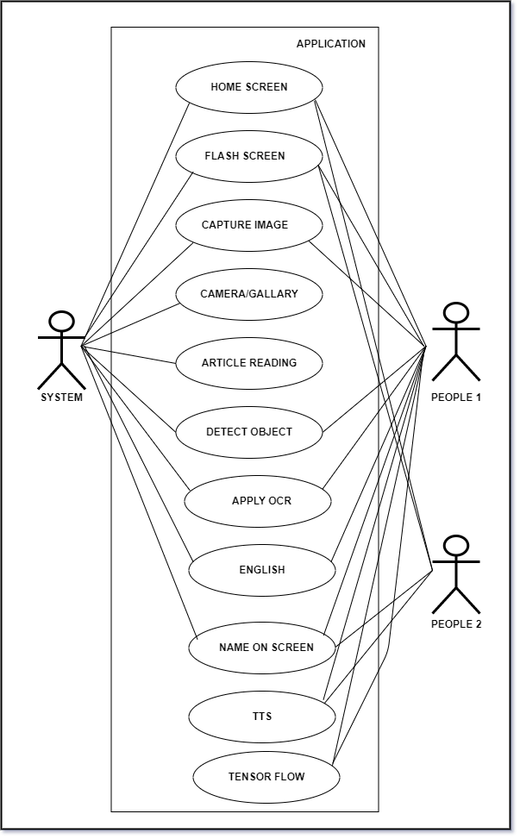
Use Case Diagram
Object detection using Tensor flow algorithm

Slide 24
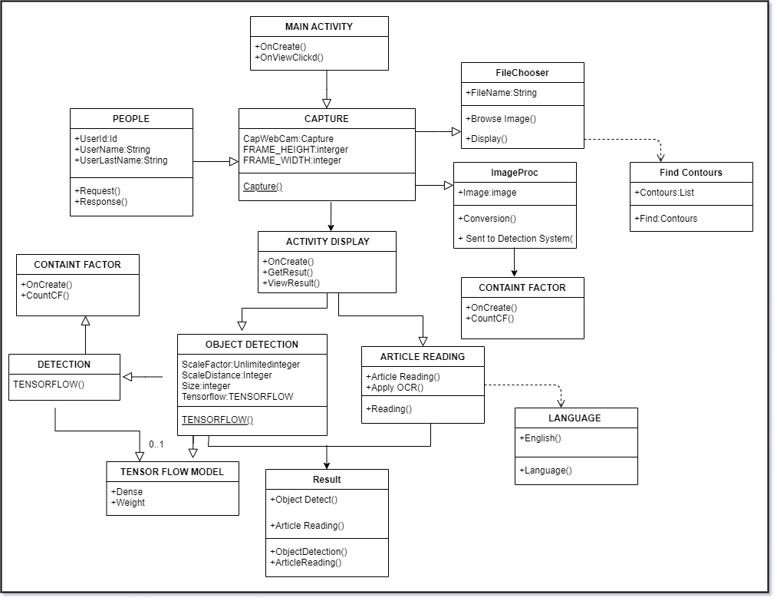
Class Diagram
Object detection using Tensor flow algorithm

Slide 25
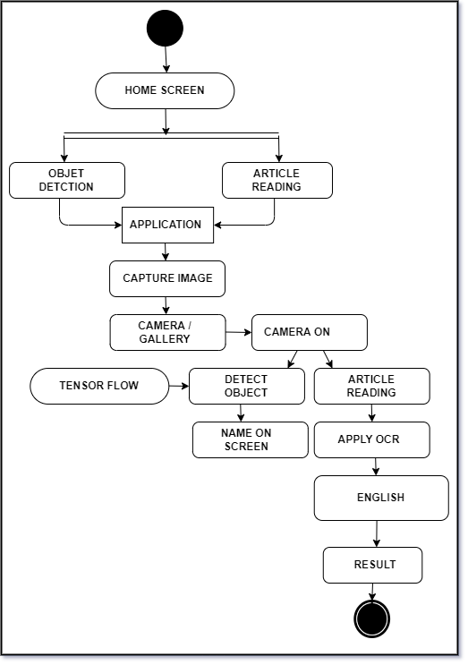
Activity Diagram
Object detection using Tensor flow algorithm

Slide 26
Merits
User Friendly.
Access to authorized person only.
No additional devices need to be carried for motion and object detection.

Slide 27
Conclusion
An accurate & efficient object detection using tensor flow for blind person and nursery children through voice recognization.
This project uses recent techniques in field of computer vision, we develop a blind visualization system that helps blind people better explore the surrounding environment.
We have developed an Android application for visually impaired .This Application is very helpful towards the visually impaired people and makes very easy for them to use electronic gadgets with TTS technology.

Slide 28
References
[1]Anirban Sarkar, Ayush Goyal , David hicks and saikat hazra” Android Application Development: A BriefOverview of Android Platforms and Evolution of Security Systems”2019 third International Conference on I-SMAC
[2]Jayshre Punsare, Adit Gaikwad, Vaishnavi Ankarm,Priyanka Kare & Sikha Sharma “Real time TextReader” International Journal of ComputerApplications 182(34):42-45, December 2018
[3]M. T. B. R. A. A. K. Y. Kevin Labuan, “A Wearable Portable Electronic Travel Aid for Blind,” in International Conference on Electrical, Electronics, and Optimization Techniques (ICEEOT), 2016
[4]Sharaddha Uddhav Khadilkar, Narendra Waghdarikar,” Android Phone Controlled Voice Gesture and Touch Screen Operated Smart Wheel Chair”, International Conference on Pervasive Computing (ICPC), 2015
[5]Rohit Rastogi, Shashank Mittal, Sajan Agarwal, A Novel Approach for Communication among Blind, Deaf and Dumb People, 2nd International Conference on Computing for Sustainable Global Development (INDIACom), March, 2015.
[6]Jackson, Richard M. Jackson and Presley, Audio-Supported Reading for Students who are Blind or Visually Impaired, Wakefield, MA: National Center on Accessing the General Curriculum, 2012.

Slide 29


